Slide 1
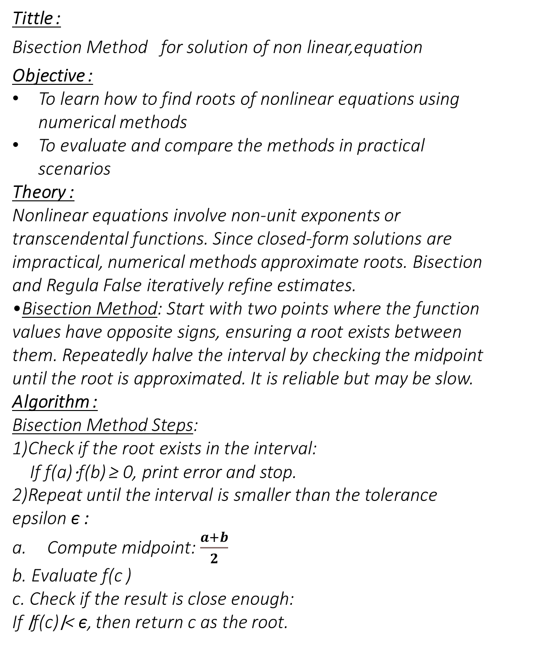
Tittle :
Bisection Method for solution of non linear,equation
Objective :
To learn how to find roots of nonlinear equations using numerical methods
To evaluate and compare the methods in practical scenarios
Theory :
Nonlinear equations involve non-unit exponents or transcendental functions. Since closed-form solutions are impractical, numerical methods approximate roots. Bisection and Regula False iteratively refine estimates.
Bisection Method: Start with two points where the function values have opposite signs, ensuring a root exists between them. Repeatedly halve the interval by checking the midpoint until the root is approximated. It is reliable but may be slow.
Algorithm :
Bisection Method Steps:
1)Check if the root exists in the interval:
If f(a)⋅f(b) ≥ 0, print error and stop.
2)Repeat until the interval is smaller than the tolerance epsilon ϵ :
Compute midpoint: $\frac{a+b}{2}$
b. Evaluate f(c )
c. Check if the result is close enough:
If ∣f(c)∣< ϵ, then return c as the root.

Slide 2
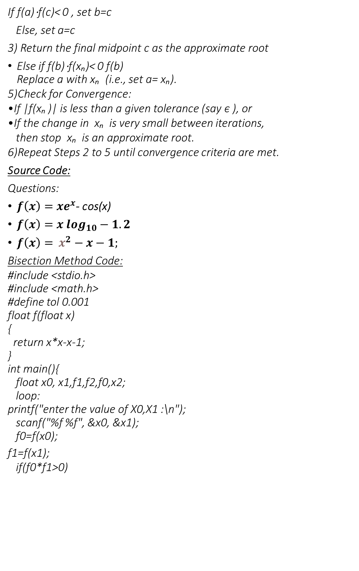
If f(a)⋅f(c)< 0 , set b=c
Else, set a=c
3) Return the final midpoint c as the approximate root
Else if f(b)⋅f(xₙ)< 0 f(b) Replace a with xₙ (i.e., set a= xₙ​).
5)Check for Convergence:
If |f(xₙ )| is less than a given tolerance (say ϵ ), or
If the change in xₙ ​ is very small between iterations, then stop xₙ ​ is an approximate root.
6)Repeat Steps 2 to 5 until convergence criteria are met.
Source Code:
Questions:
$f\left(x\right)=xe^{x}$- cos(x)
$f\left(x\right)=x \log_{10}−1.2$
$f\left(x\right)=$ $x^{2}−x−1;$
Bisection Method Code:
#include <stdio.h>
#include <math.h>
#define tol 0.001
float f(float x)
{
return x*x-x-1;
}
int main(){
float x0, x1,f1,f2,f0,x2;
loop:
printf("enter the value of X0,X1 :\n");
scanf("%f %f", &x0, &x1);
f0=f(x0);
f1=f(x1);
if(f0*f1>0)
bisection method

Slide 3
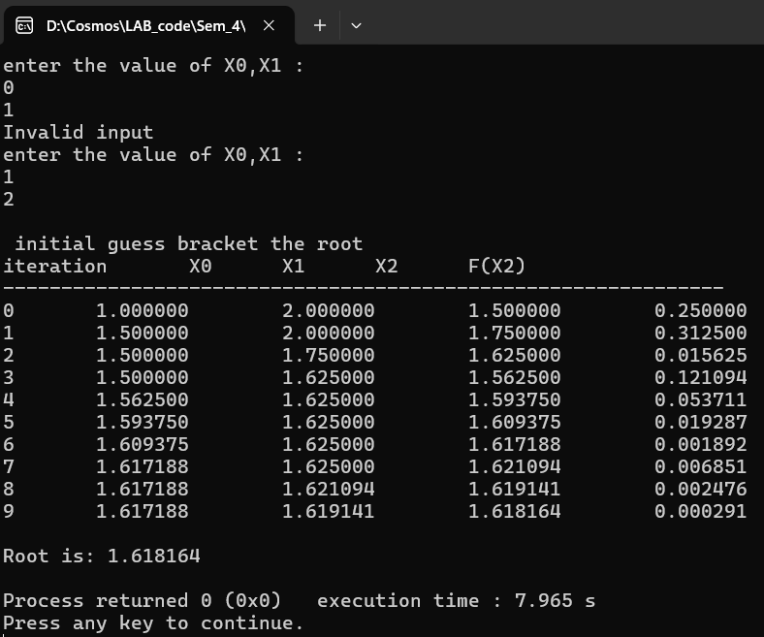
{
printf("Invalid input\n");
goto loop;
}
else
{
printf("\n initial guess bracket the root\n");
}
c printf("iteration\tX0\tX1\tX2\tF(X2)\n");
printf("--------------------------------------------------------------\n");
int iteration=0;
do{
x2=(x0+x1)/2;
f2=f(x2);
printf("%d\t%f\t%f\t%f\t%f\n", iteration, x0, x1, x2,fabs(f2));
iteration++;
if(f2 == 0)
break;
else if (f0*f2<0)
x1=x2;
else
x0=x2;
}while(fabs(f2)>tol);
printf("\nRoot is: %f\n", x2);
return 0;
}
Output :

Slide 4
Discussion & Conclusion:
The Bisection Method was used to approximate the root of a nonlinear equation by iteratively halving an interval where a sign change occurred. While it provided a structured and reliable approach, the method was relatively slow, requiring multiple iterations for improved accuracy. The experiment confirmed its effectiveness but also highlighted its computational expense compared to faster alternatives. Despite its limitations, the Bisection Method remains a fundamental numerical technique for solving equations when analytical solutions are impractical.

